Slide 1
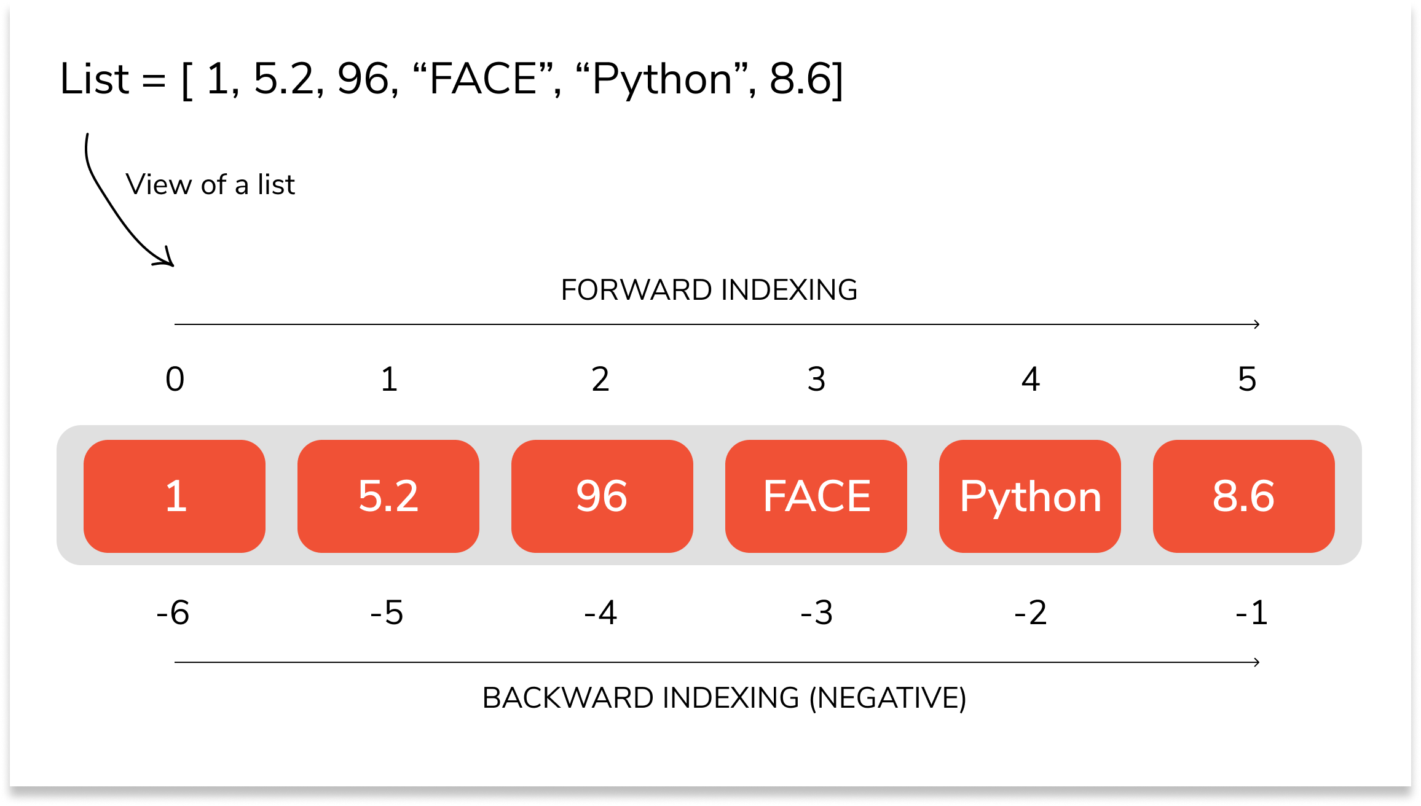
PYTHON LISTS

Slide 2
DEFINITONS
The most basic data structure in Python is the sequence. Each element of a sequence is assigned a number - its position or index. The first index is zero, the second index is one, and so forth.
Python has six built-in types of sequences, but the most common ones are lists and tuples, . list may contain mutable elements. A list may contain duplicate values with their distinct positions and hence, multiple distinct or duplicate values can be passed as a sequence at the time of list creation.

Slide 3
DEFINITONS
The list is a most versatile datatype available in Python which can be written as a list of comma-separated values (items) between square brackets. Important thing about a list is that items in a list need not be of the same type.
Creating a list is as simple as putting different comma-separated values between square brackets. . List literals are written within square brackets [ ]. Lists work similarly to strings -- use the len() function and square brackets [ ] to access data, with the first element at index 0

Slide 4
DEFINITONS
Ordered
When we say that lists are ordered, it means that the items have a defined order, and that order will not change.
If you add new items to a list, the new items will be placed at the end of the list.
There are some list methods that will change the order, but in general: the order of the items will not change.

Slide 5
DEFINITONS
Changeable
The list is changeable, meaning that we can change, add, and remove items in a list after it has been created.
Allow Duplicates
Since lists are indexed, lists can have items with the same value:.

Slide 6
A list can contain different data types
A list with strings, integers and boolean values:
list1 = [“Yemisi", 34, True, 40, "male“,”false”,(1,2,3,4)]

Slide 7
Creating Lists
# Creating a List of numbers
numbers = [10, 20, 14,23,45,67,11,22,90]
print("\nList of numbers: ")
print(List)

Slide 8
Creating Lists
# Creating a Multi-Dimensional List
# (By Nesting a list inside a List)
dm = [[1,2,3,4,5,6,7,,8,9,0] , [11,2,33,44,55,66,77,88,99,100]]
print("\nMulti-Dimensional List: ")
print(List)

Slide 9
Operations on Lists

Slide 10
Accessing Values in Lists
To access values in lists, use the square brackets for slicing along with the index or indices to obtain value available at that index
Numbers[5]
In order to access the list items refer to the index number.Use the index operator [ ] to access an item in a list.The index must be an integer.Nested list are accessed using nested indexing.
Dm[0][4]

Slide 11
Accessing Values in Lists
In Python, negative sequence indexes represent positions from the end of the array.
List[len(List)-3], is the same as List[-3].
Negative indexing means beginning from the end, -1 refers to the last item, -2 refers to the second-last item, etc.

Slide 12
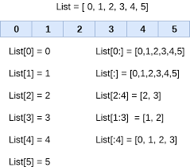
Accessing Values in Lists

Slide 13
Accessing Values in Lists –ve indexing

Slide 14
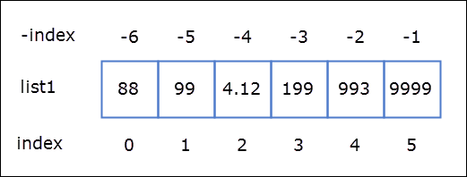
Accessing Values in Lists –ve indexing

Slide 15
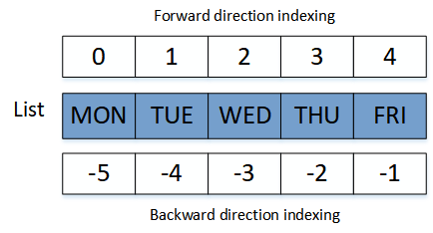
Accessing Values in Lists –ve indexing

Slide 16
Change Item Value
To change the value of a specific item, refer to the index number:
Students=[“Ayo”,”Mariam”,”Tumise”,”Bola”,”Emma”,”John”]
Students[3]= “Joseph”
Print(students)

Slide 17
Copying Lists
Assignment with an = on lists does not make a copy. Instead, assignment makes the two variables point to the one list in memory.
Students=[“Ayo”,”Mariam”,”Tumise”,”Bola”,”Emma”,”John”]
copyStudents= Students
Students and copyStudents refer to the same lists in memory
print('ID :', id(students))
print('ID :', id(copyStudents))
The problem with copying lists in this way is that if you modify new_list, old_list is also modified.
It is because the new list is referencing or pointing to the same old_list object.

Slide 18
Copying Lists - the copy() method.
The copy() method returns a new list. It doesn't modify the original list.
import copy
Students=[“Ayo”,”Mariam”,”Tumise”,”Bola”,”Emma”,”John”]
copyStudents= Students.copy()
Students and copyStudents refer to the different lists in memory

Slide 19
Copying Lists - the copy() module.
The copy() method returns a new list. It doesn't modify the original list.
import copy
Students=[“Ayo”,”Mariam”,”Tumise”,”Bola”,”Emma”,”John”]
copyStudents= copy.copy(Students.copy)
The new object is an independent lists

Slide 20
Copying Lists -.
An Analysis
A shallow copy means if we modify any of the nested list elements, changes are reflected in both the list as they point to the same reference. Whereas in deep copy, when we add an element in any of the lists, only that list is modified. When we use “=” operator the new list refers to the same object, hence any change (append, remove, change of value) in one list is reflected on both. But when we use list.copy() method, changes made to one list or not reflected on other except for in nested elements (like list within list), Here we should use copy.deepcopy() from the copy module to avoid this problem

Slide 21
Copy List Using Slicing Syntax
Assignment with an = on lists does not make a copy. Instead, assignment makes the two variables point to the one list in memory.
Students=[“Ayo”,”Mariam”,”Tumise”,”Bola”,”Emma”,”John”]
copyStudents= Students[:]
Students and copyStudents refer to the seoarate lists in memory
students.append(“DeBode”).
P
Print(students)
print(copyStudents)

Slide 22
Update Lists
You can update single or multiple elements of lists by giving the slice on the left-hand side of the assignment operator, and you can add to elements in a list with the append() method.
Elements can be added to the List by using built-in append() function. Only one element at a time can be added to the list by using append() method, for addition of multiple elements with the append() method, loops are used. Tuples can also be added to the List with the use of append method because tuples are immutable. Unlike Sets, Lists can also be added to the existing list with the use of append() method.

Slide 23
Add items to a Lists – append()
Students.append(“Yetunde”).
list.append(elem) –
This adds a single element to the end of the list. It does not return the new list, just modifies the original. Using the append() method to append an item

Slide 24
Adding elements to the List using Iterator
for i in range(1, 4):
List.append(i)
print("\nList after Addition : ")
print(List)

Slide 25
Addition of List to a List
Newstudennts=[“yele”,”Kemi”,”mathew”]
Students.apend(newstudents)

Slide 26
Using insert() method
append() method only works for addition of elements at the end of the List,.
To add an element at the desired position, insert() method is used.
Unlike append() which takes only one argument, insert() method requires two arguments(position, value).
insert (position, value).

Slide 27
Update Lists –Using insert() method
Students.insert(4,“Kolawole”)
Print (students)
To insert a list item at a specified index, use the insert() method.
The insert() method inserts an item at the specified index

Slide 28
Using extend() method
This method is used to add multiple elements at the same time at the end of the list. To append elements from another list to the current list, use the extend() method.
Note – append() and extend() methods can only add elements at the end.
Students.extend([“John”,”Peter”,”Mona”])

Slide 29
Update Lists –+ and * Operations
Lists respond to the + and * operators much like strings; they mean concatenation and repetition here too, except that the result is a new list, not a string.

Slide 30
Lists Operations
Concacenation
Students + newstudents.
Repeatition
Students * newstudents.
Membership
“Kemi” in Students
“Kemi” not in Students

Slide 31
Lists –Operations, Iterating through a list
iteration
for x in Students:
print x
i=0
While i < len(Student):
print(Student[i])
i=i+1;

Slide 32
Lists –Operations access item by indices
list.index(elem) -- searches for the given element from the start of the list and returns its index. Throws a ValueError if the element does not appear
Student.index(“mark”)
Student.index(“Yemi”)
Student.index(“yemi”)
***(use "in" to check first so as to avoid the ValueError).

Slide 33
Lists –Operations List cmp() Method
outdated

Slide 34
Lists –Operations List len() Method
The len() function can be used to find the "length" or number of items within a list. Be aware, however, that this function begins counting at 1 instead of 0 as is usual for listing in Python.
The following list is a list of student names:

Slide 35
Lists –Operations len() Method
students=["Bello Sanni","Wale Adams",
"Jamiu Adeleye","Mathew Osundu","Tunde Mikels","John Ochugbo"
"Mary Ngozi","Funmi Awale","Beuty Bella","Yemisi Adeleke","Bunmi Esho"
]

Slide 36
Lists –Operations List len() Method
This method returns the number of elements in the list.
Len(students)

Slide 37
List list() Method
list() takes sequence types and converts them to lists. This is used to convert a given tuple into list.
Note − Tuple are very similar to lists with only difference that element values of a tuple can not be changed and tuple elements are put between parentheses instead of square bracket.

Slide 38
List list() Method
list() takes sequence types and converts them to lists. This is used to convert a given tuple into list.
Note − Tuple are very similar to lists with only difference that element values of a tuple can not be changed and tuple elements are put between parentheses instead of square bracket.

Slide 39
List max(),min() Method
The Python max() function is used to find the largest value in a list of values. The Python min() function is used to find the lowest value in a list. The list of values can contain either strings or numbers. You can pass an iterable like a list or a list tuple as an argument to the min() method. If an iterable is empty, a ValueError is raised

Slide 40
List max(),min() Method
method max returns the elements from the list with maximum value.
list1 = [123, 'xyz', 'zara', 'abc'],
list2 =[456, 700, 200]
print "Max value element : ", max(list1)
print "Max value element : ", max(list2).

Slide 41
List max(),min() Method
Python Min and Max with Strings can also be used to find the smallest and largest characters in a string. In this case, smallest and largest refer to the position of the character in the alphabet.
The smallest possible character is the capital letter A, since all capital letters come first in Python. Our largest character is the lowercase letter z.

Slide 42
List max(),min() Method
the Unicode values for lowercase characters a through e in the Basic Latin alphabet:
97 98 99 100 101
.you can check using
ord(character)
The ord() method only takes in one character at a time.

Slide 43
List ord() Method
Python ord() function returns the Unicode code from a given character. This function accepts a string of unit length as an argument and returns the Unicode equivalence of the passed argument. In other words, given a string of length 1, the ord() function returns an integer representing the Unicode code point of the character when an argument is a Unicode object, or the value of the byte when the argument is an 8-bit string.

Slide 44
List ord() Method
Python ord() example
For example, ord(‘a’) returns the integer 97, ord(‘€’) (Euro sign) returns 8364. This is the inverse of chr() for 8-bit strings and of unichr() for Unicode objects. If a Unicode argument is given and Python is built with UCS2 Unicode, then the character’s code point must be in the range [0..65535] inclusive.
Note: If the string length is more than one, and a TypeError will be raised. The syntax can be ord(“a”) or ord(‘a’), both will give same results.
Example 1: Demonstration of Python ord() function
# inbuilt function return an
# integer representing the Unicode code
value = ord("A")
# writing in ' ' gives the same result
value1 = ord('A')
# prints the unicode value
print (value, value1)

Slide 45
List ord() Method
Python ord() Error Condition
A TypeError is raised when the length of the string is not equal to 1 as shown below:
# inbuilt function return an
# integer representing the Unicode code
# demonstrating exception
# Raises Exception
value1 = ord('AB')
# prints the unicode value
print(value1)

Slide 46
List List pop() Method
This method returns the removed object from the list.This method returns the removed object from the list.
Students.pop()
You can supply an optional parameter, index of the object to be removed from the list.
Students.pop(3)

Slide 47
List List remove() Method
remove() searches for the given element in the list and removes the first matching element.
This Python list method does not return any value but removes the given object from the list.
Student.remove(“Debode”)

Slide 48
List sort() Method
method sort() sorts objects of list.
it use s compare func if given.
The method does not return any value
but it changes the original list.
The sort() method sorts the list ascending by default.
You can also make a function to decide the sorting criteria(s).
Syntax
list.sort(reverse=True|False, key=myFunc)
Students.sort(reverse=True)
Students.sort()

Slide 49
List sort() Method-an example
def myFunc(e):
return e['year']
cars = [
{'car': 'Ford', 'year': 2005},
{'car': 'Mitsubishi', 'year': 2000},
{'car': 'BMW', 'year': 2019},
{'car': 'VW', 'year': 2011}
]
cars.sort(key=myFunc)

Slide 50
List sort() Method-an example
def myFunc(e): return len(e) students.sort(reverse=True, key=myFunc)

Slide 51
List reverse() Method
Python list method reverse() reverses objects of list in place. This method does not return any value but reverse the given object from the list.
Syntax
list.reverse()

Slide 52
List count() Method
method count() returns count of how many times obj occurs in list. This method returns count of how many times obj occurs in list.
Syntax
list.count(obj)

Slide 53
List List Comprehension
List comprehension offers a shorter syntax when you want to create a new list based on the values of an existing list.

Slide 54
List List Comprehension -
fruits = ["apple", "banana", "cherry", "kiwi", "mango"] newlist = [] for x in fruits: if "a" in x: newlist.append(x) print(newlist)
The above can be written as follows:

Slide 55
List List Comprehension - illustration
fruits = ["apple", "banana", "cherry", "kiwi", "mango"]
newlist = [x for x in fruits if "a" in x]
print(newlist)

Slide 56
List List Comprehension - illustration
The Syntax
newlist = [expression for item in iterable if condition == True]
The return value is a new list, leaving the old list unchanged.
Condition
The condition is like a filter that only accepts the items that valuate to True.

